Slide 1
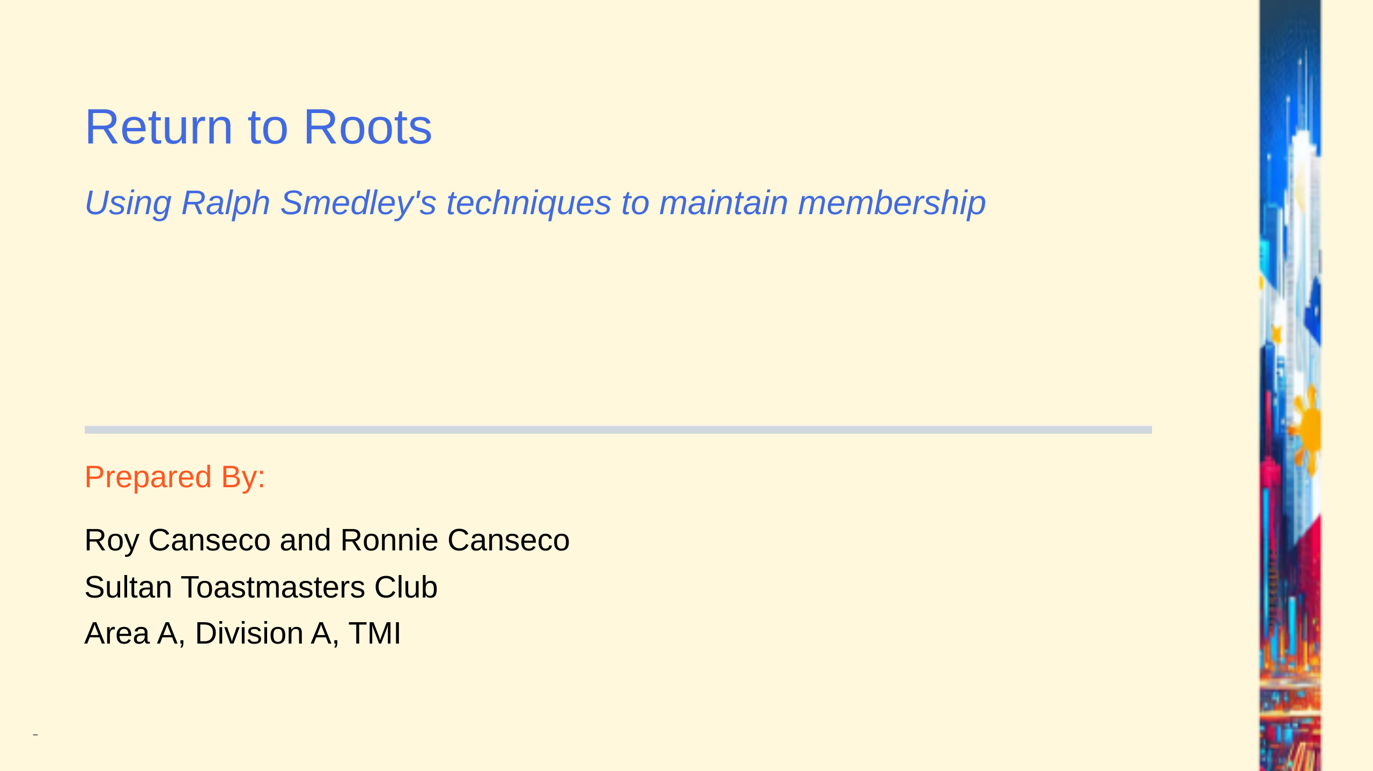
Notes:
Add this anywhere in your Markdown file
sub sub title: Super Sulit Server Setup with Linode Akamai (and Nephila)

Slide 2
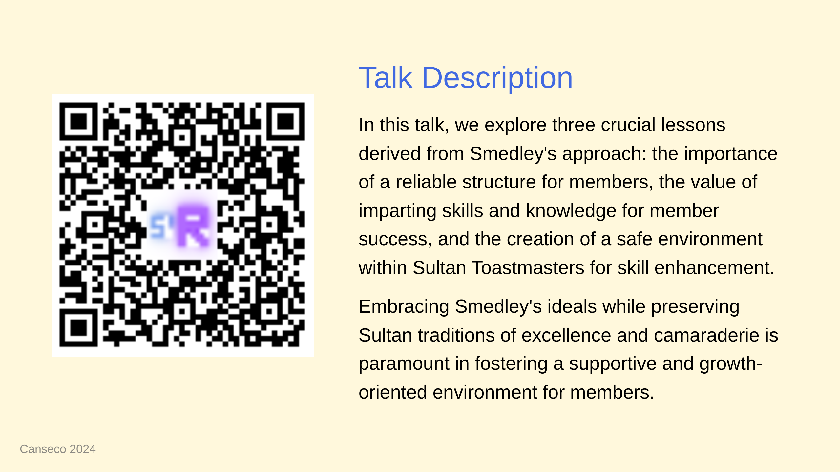

Slide 3


Slide 4
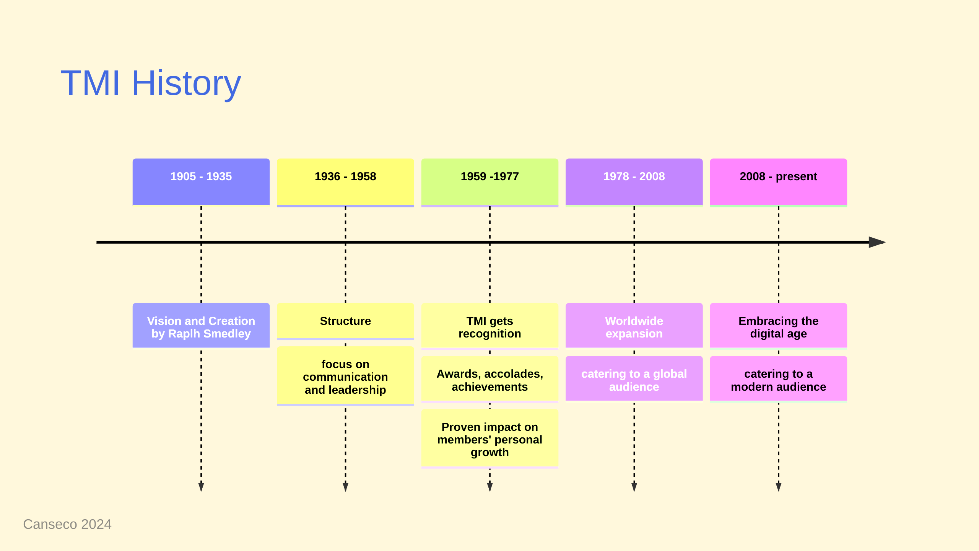
Notes:
we can take inspiration from the TMI's path to success in order to fashion our own

Slide 5


Slide 6
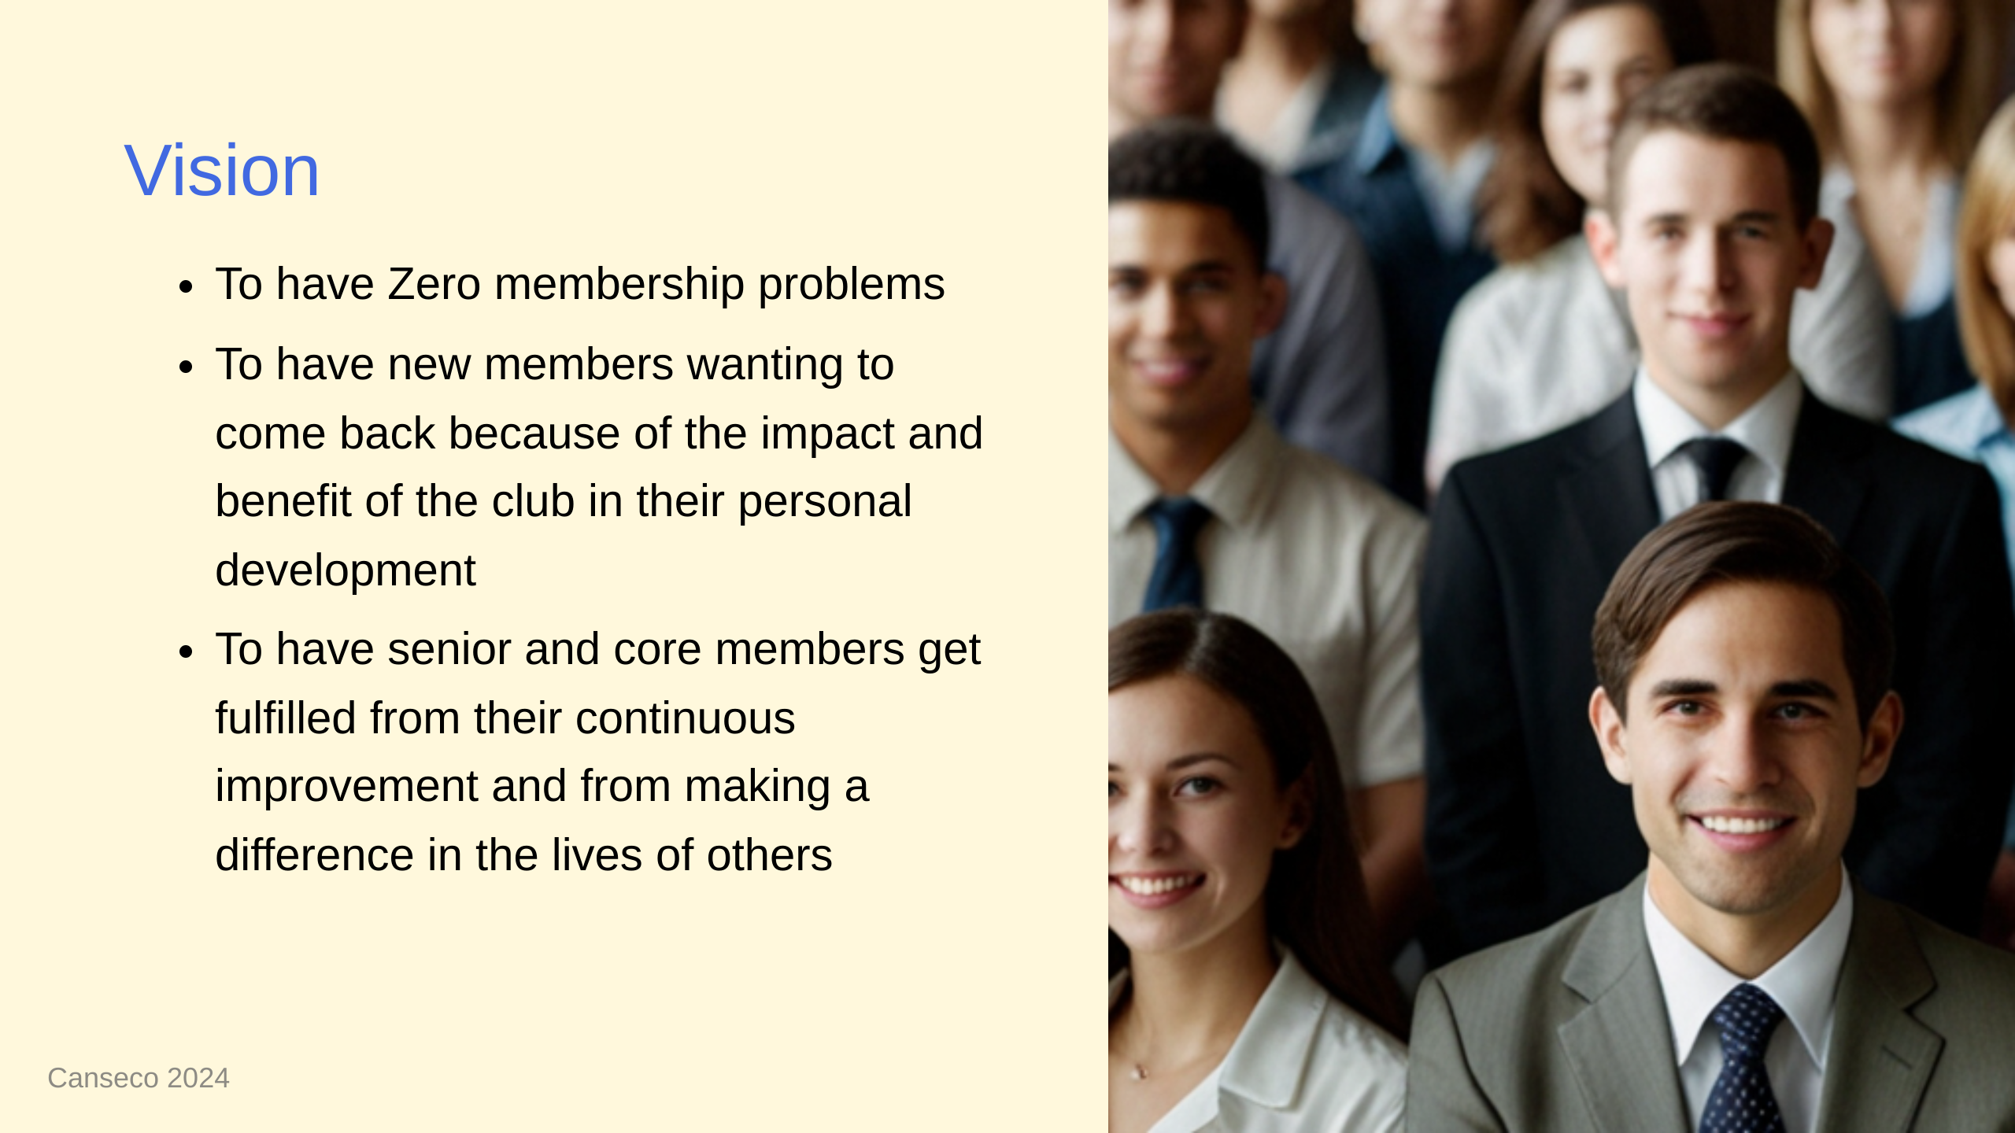

Slide 7


Slide 8
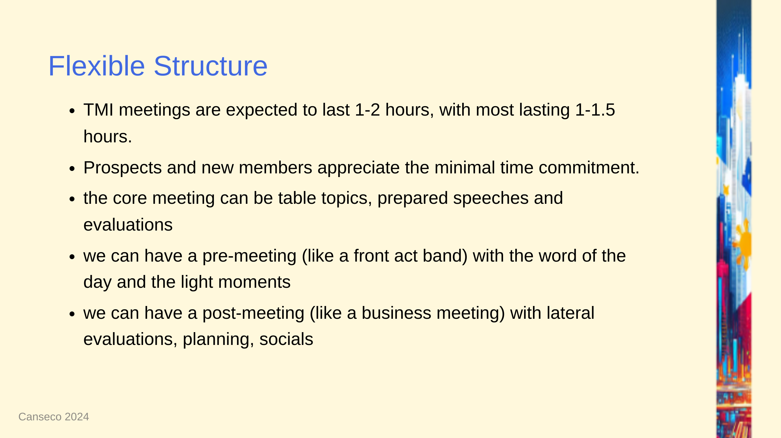

Slide 9
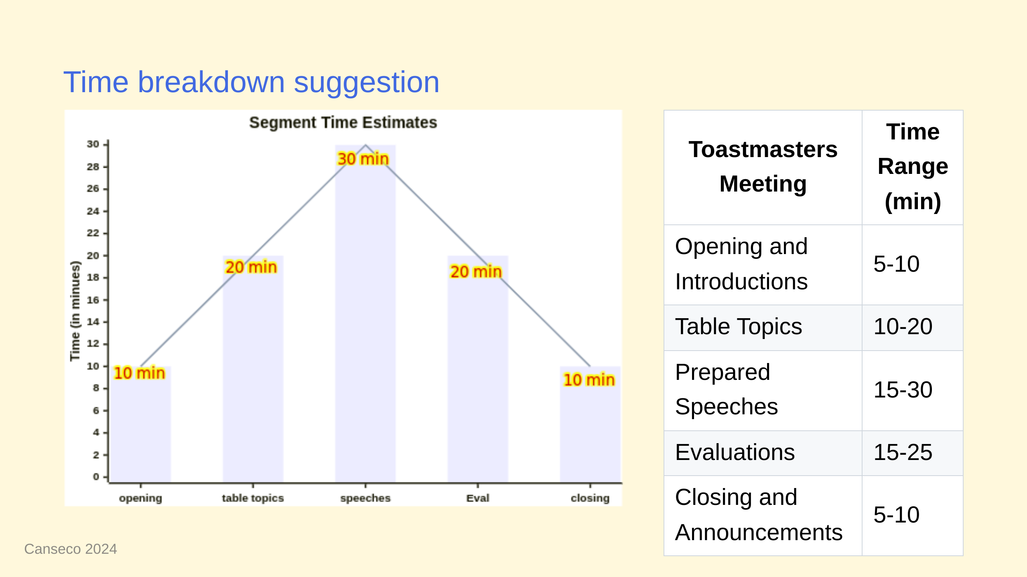

Slide 10
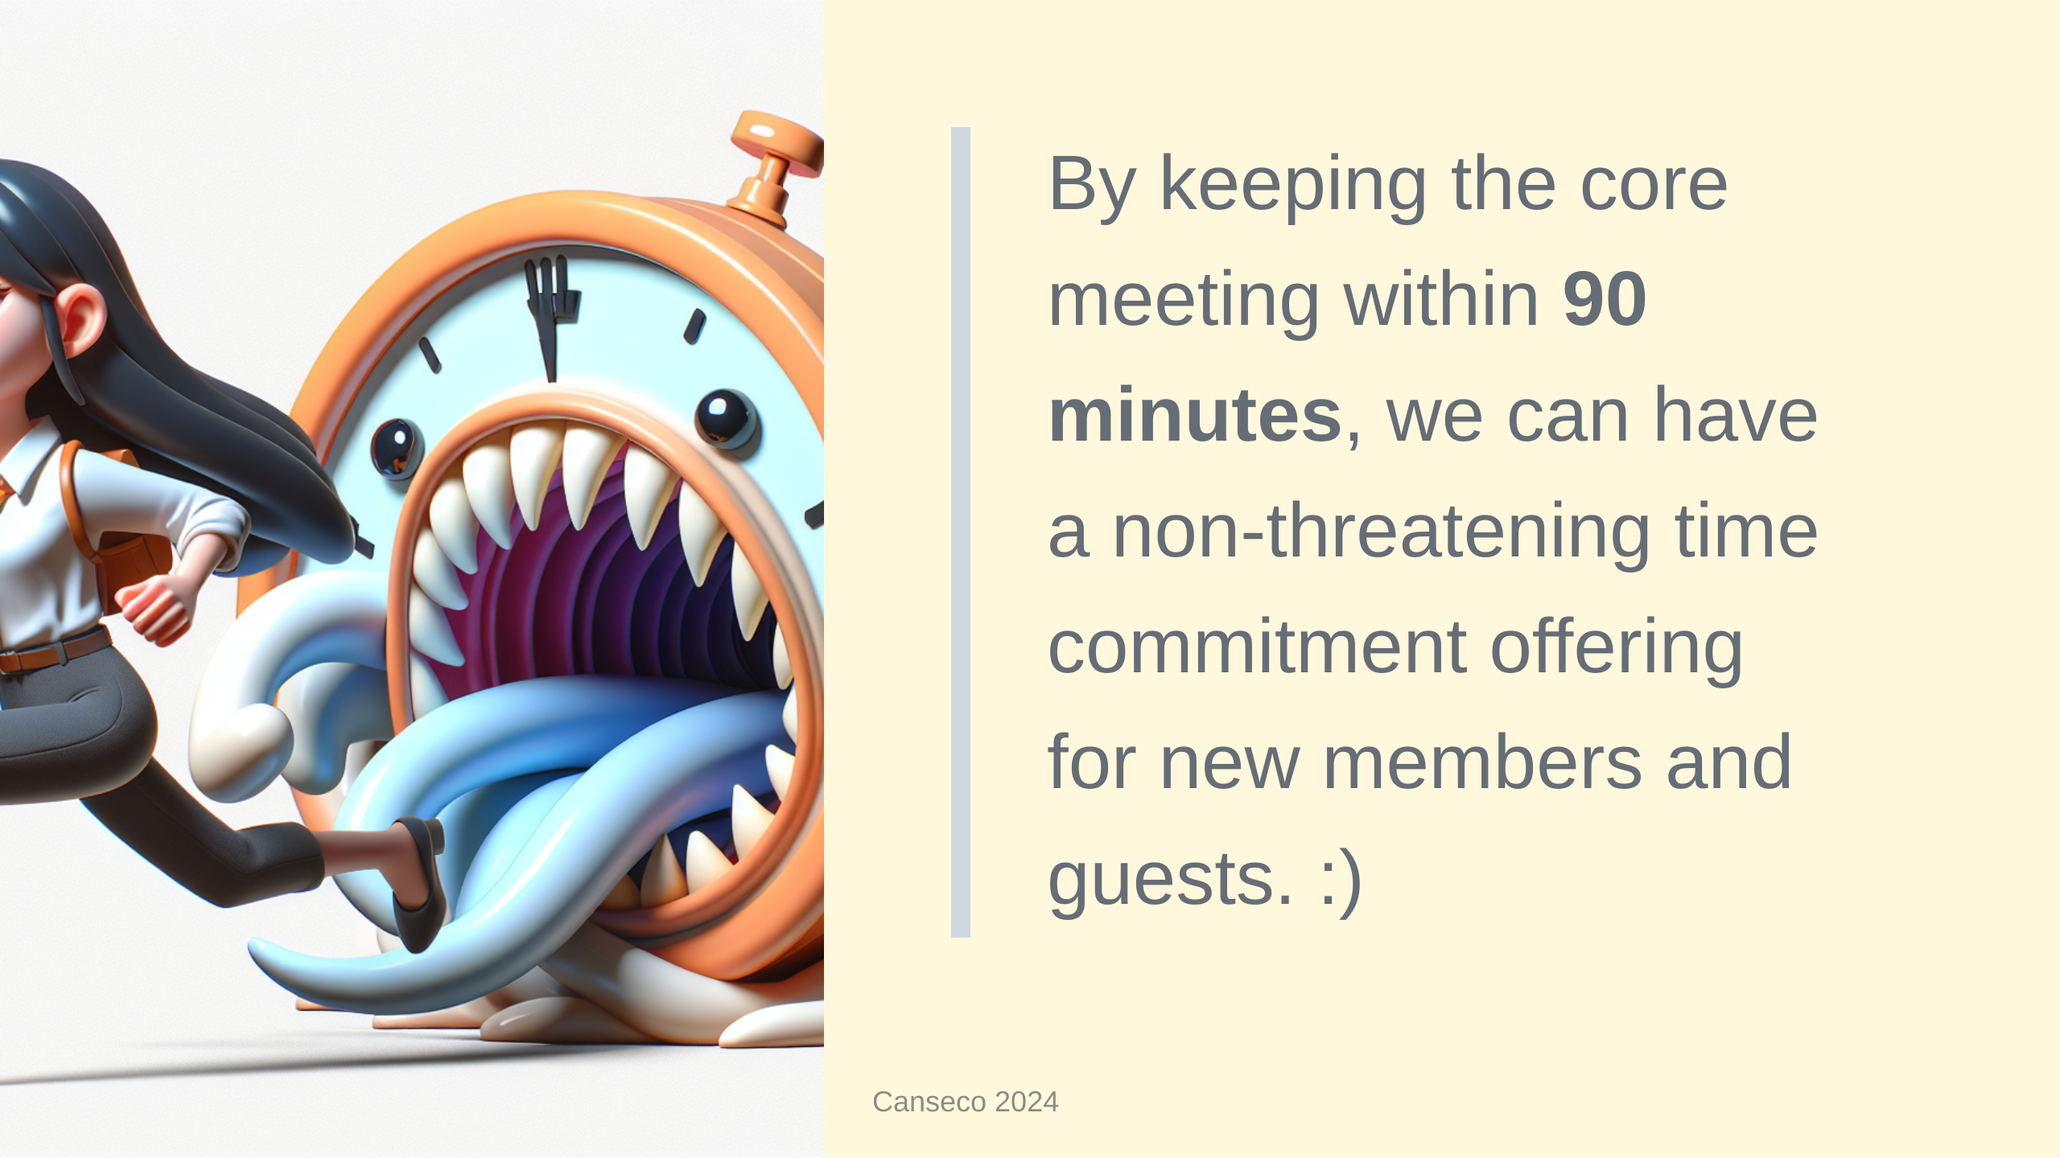

Slide 11
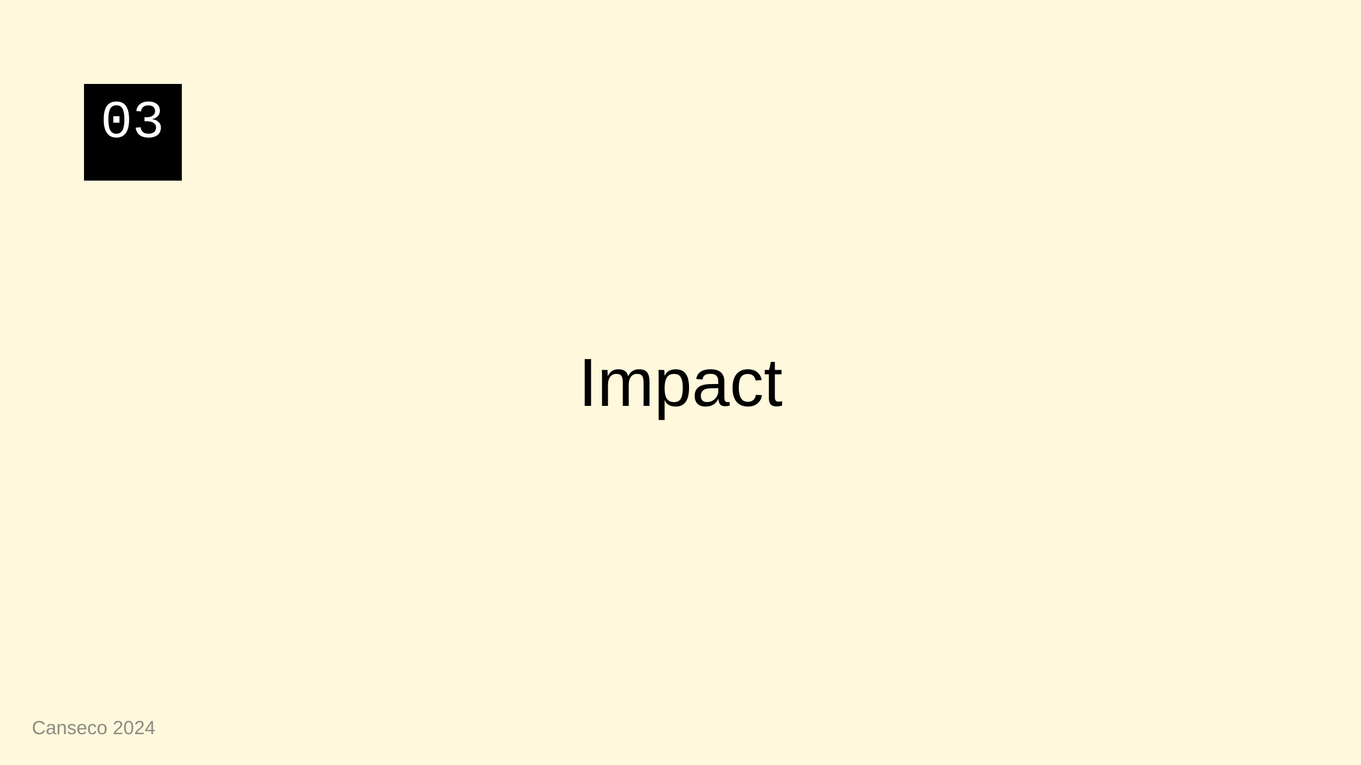

Slide 12
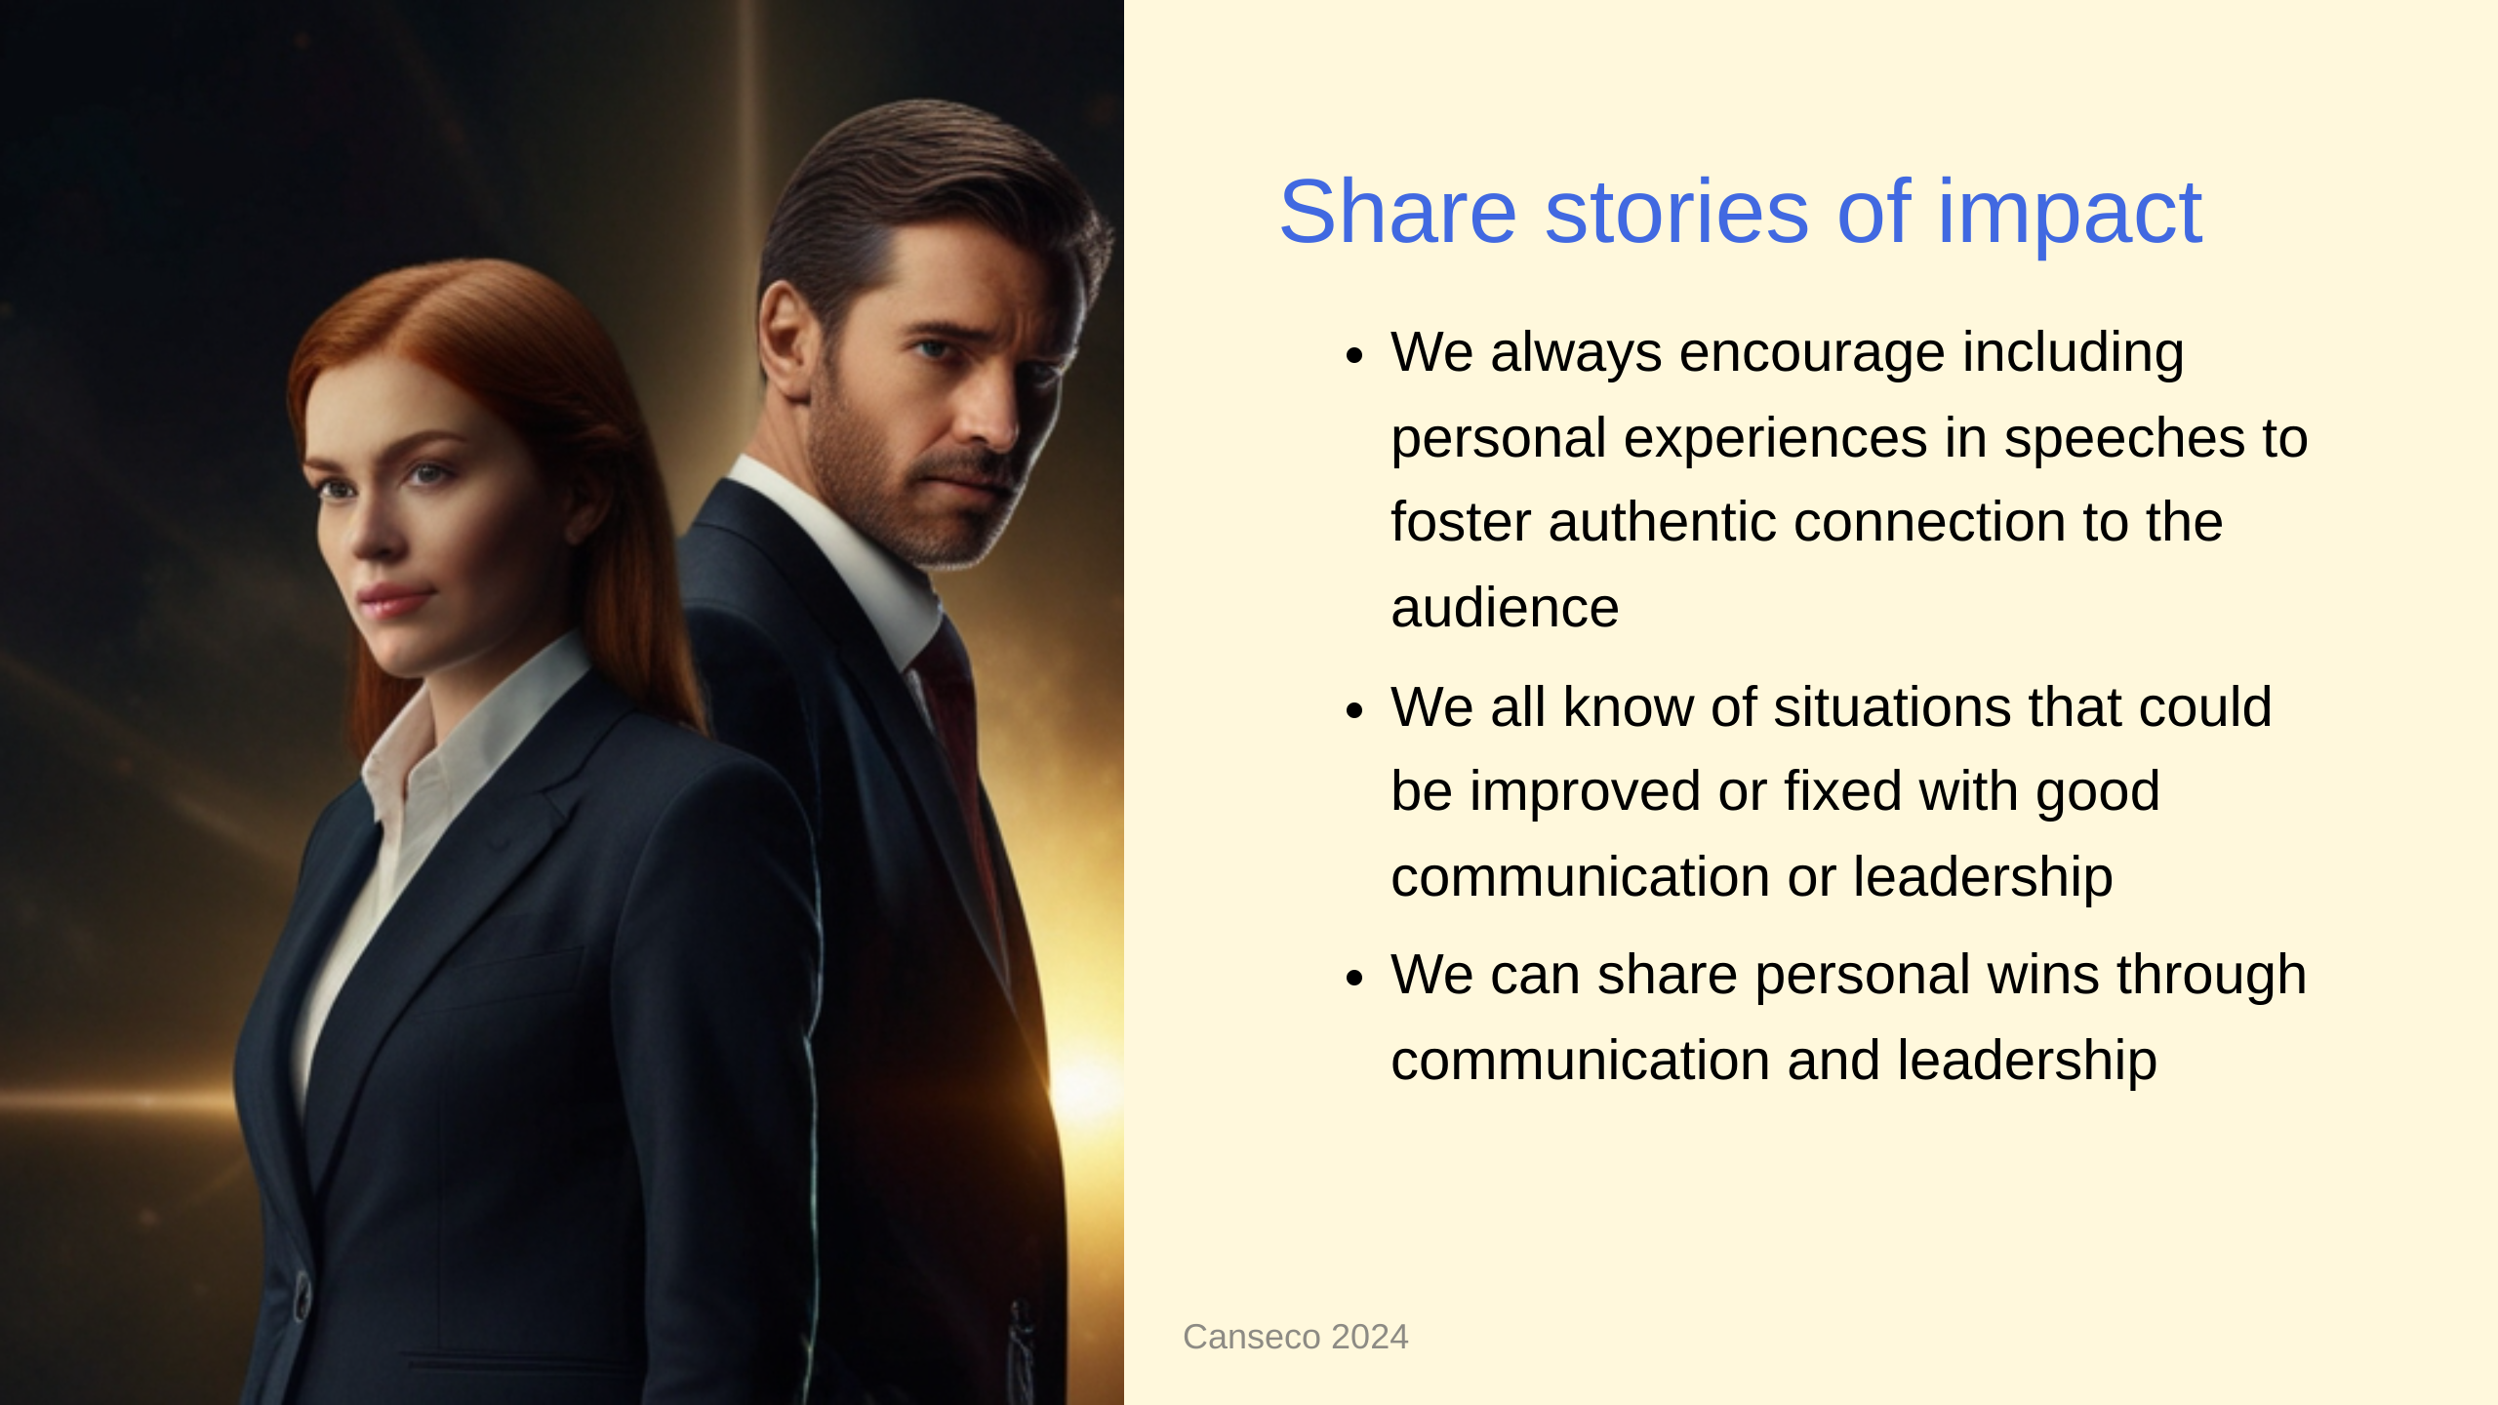

Slide 13
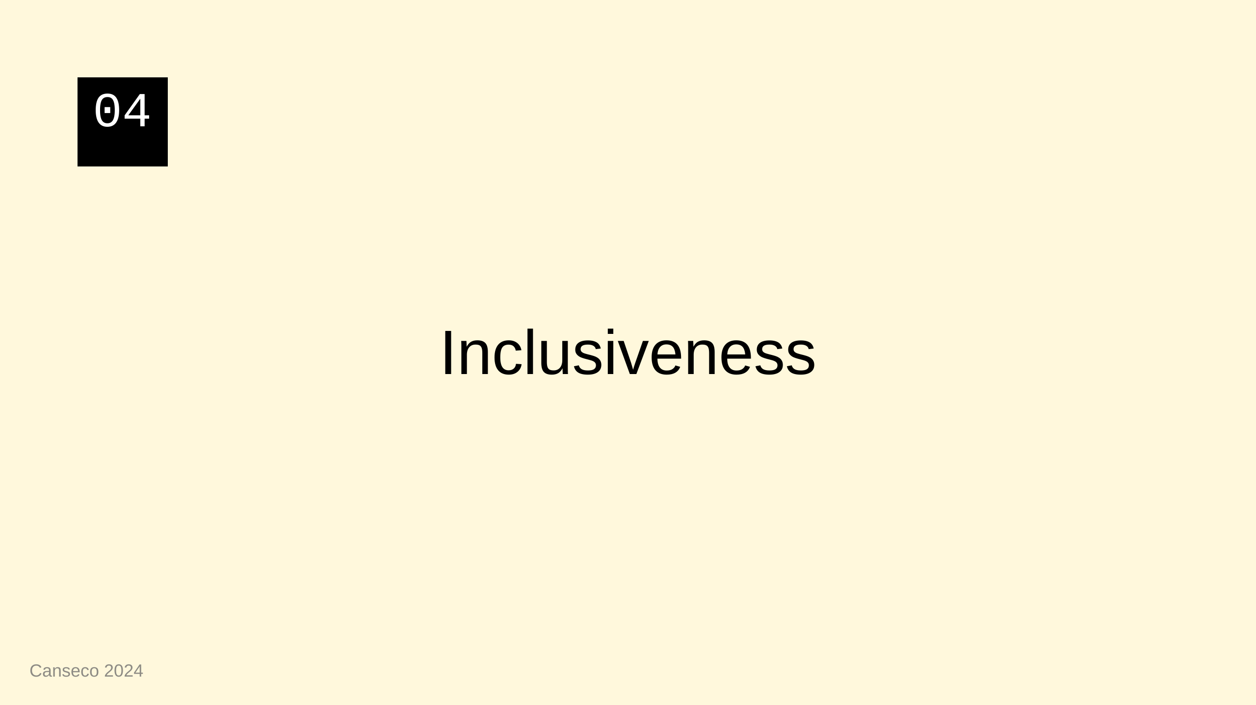

Slide 14


Slide 15
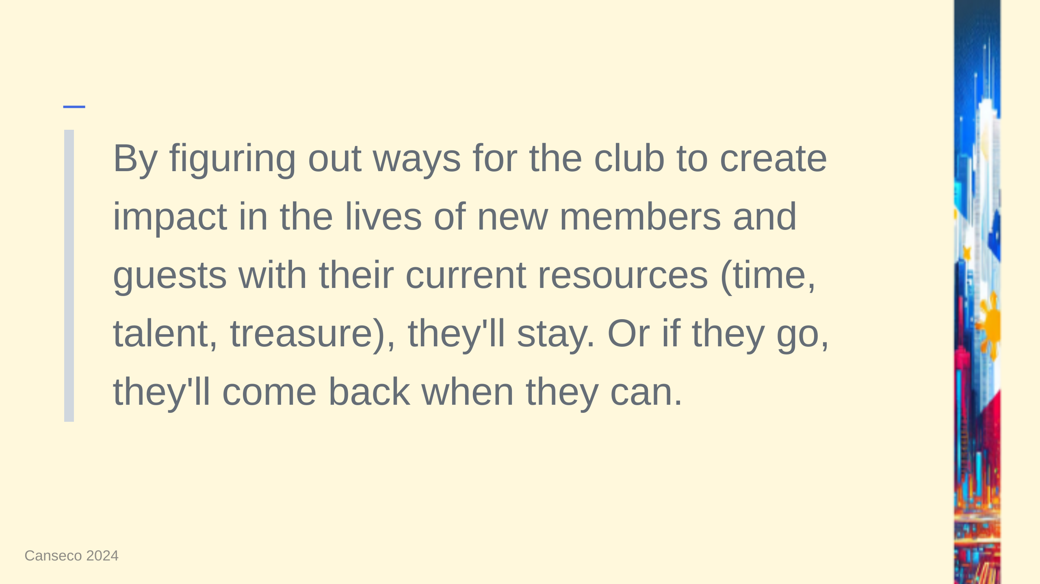

Slide 16
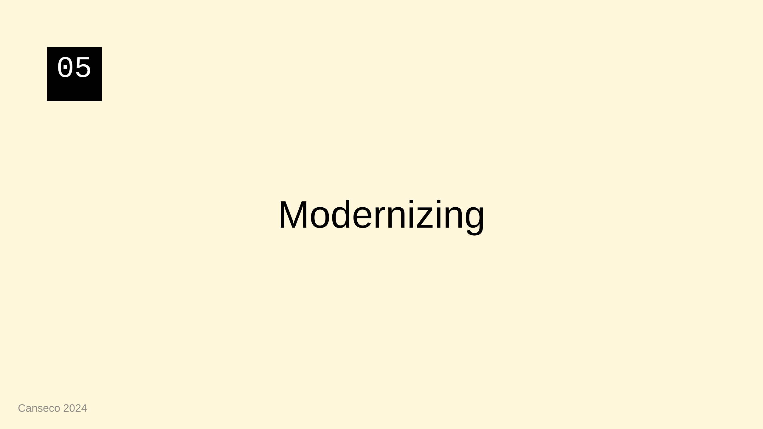

Slide 17


Slide 18
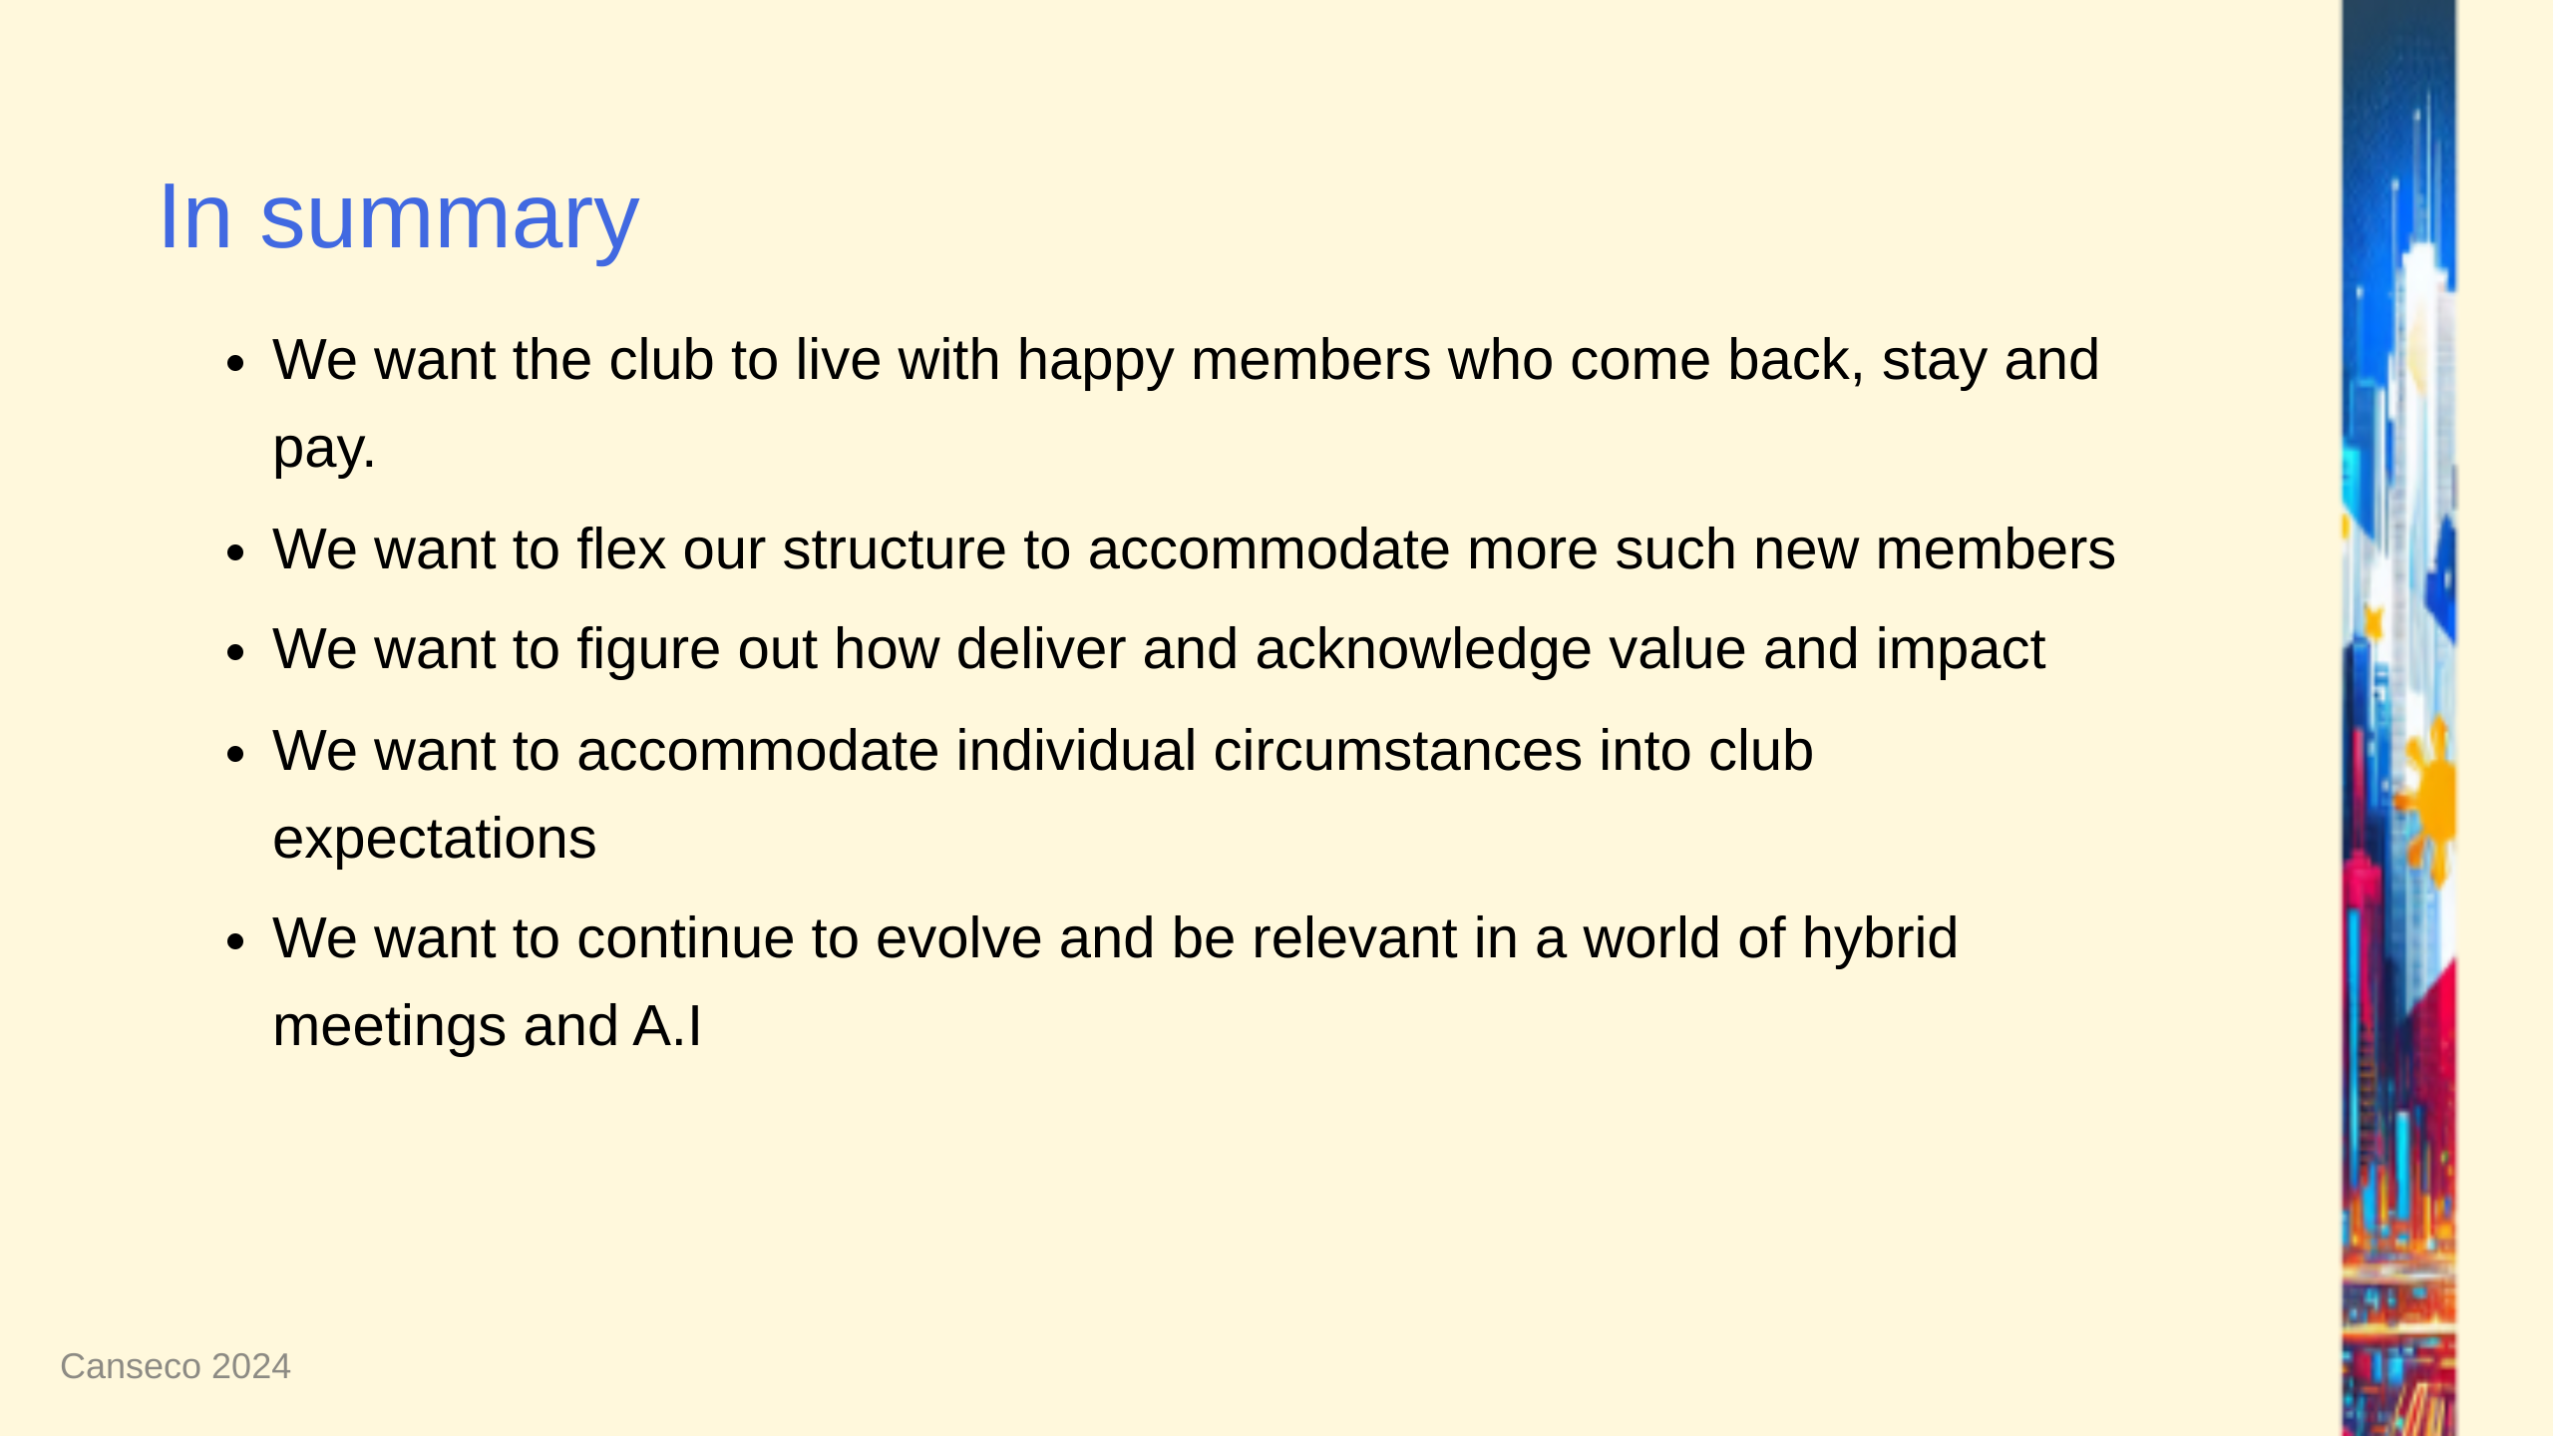

Slide 19


